Slide 1
Chapter 7 Discrete Probability
Section 4
Expected Value and Variance

Slide 2
Outline
Expected Values
Derived Random Variables
Linearity of Expectation Values
Variance & Standard Deviation

Slide 3
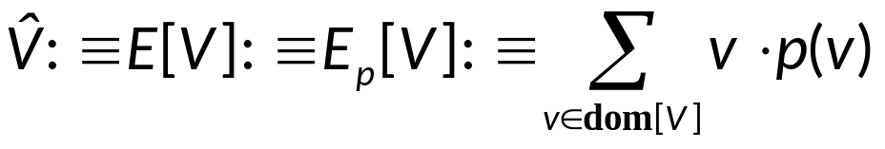
Expected Values
Expected value of V (期望值)
  For any random variable V having a numeric domain, its expected value E[V], under the probability distribution p(v), is defined as
  Notice that expectation value, weighted average value, weighted (arithmetic) mean value are also used for this.
  The term “expected value” is very widely used. But this term is somewhat misleading, since the “expected” value might itself be totally unexpected, or even impossible.

Slide 4
Expected Values
Example.
  Let p(0)=0.5, p(1)=0, p(2)=0.5. Then E[V]=1, even though p(1)=0 and so we know that V≠1.
  Or, if p(0)=0.5, p(1)=0.5, then E[V]=0.5 even if V is an integer variable.

Slide 5
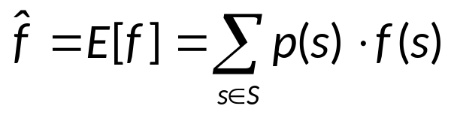
Derived Random Variables
Remark.
  Let S be a sample space over values of a random variable V (representing possible outcomes).
  Then, any function f over S can also be considered to be a random variable (whose actual value f(V) is derived from the actual value of V).
  If the range R = range[f] of f is numeric, then the mean value E[f] of f can still be defined, as

Slide 6
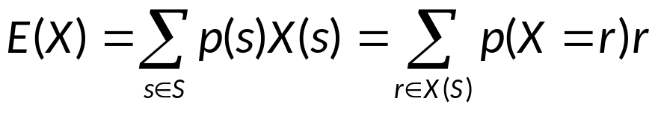
Derived Random Variables
Expected value of X
  Recall that a random variable X is actually a function
  f: S → X(S),
  where S is the sample space and X(S) is the range of X.
  This fact implies that the expected value of X is

Slide 7
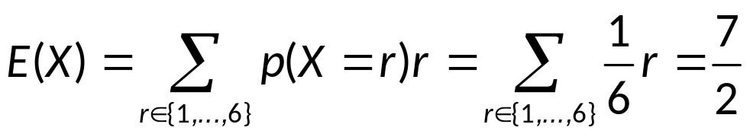
Derived Random Variables
Example. (Expected Value of a Die)
  Let X be the number that comes up when a die is rolled.

Slide 8
Derived Random Variables
Example.
  A fair coin is flipped 3 times. Let S be the sample space of 8 possible outcomes, and let X be a random variable that assignees to an outcome the number of heads in this outcome.
      E(X) = 1/8 [X(TTT) + X(TTH) + X(THH) + X(HTT) +
      X(HHT) +X(HHH) + X(THT) + X(HTH)]
      = 1/8 [0 + 1 + 2 + 1 + 2 + 3 + 1 + 2]
      = 12/8
      = 3/2

Slide 9
Linearity of Expectation Values
Theorem.
  Let X₁, X₂ be any two random variables derived from the same sample space S, and subject to the same underlying distribution.
  Then we have the following theorems:
    E[X₁+X₂] = E[X₁] + E[X₂]
    E[aX₁ + b] = aE[X₁] + b
  Proof.

Slide 10
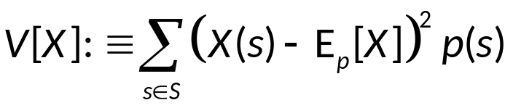

Variance & Standard Deviation
Definition. (方差)
  The variance V[X] = σ²(X) of a random variable X is the expected value of the square of the difference between the value of X and its expectation value E[X]:
Definition. (标准差)
  The standard deviation or root-mean-square (RMS) difference of random variable X is

Slide 11
Variance & Standard Deviation
Theorem.
  If X is a random variable on a sample space S, then
V[X] = E(X²) - E(X)²
  Proof.
Example.
  What is the variance of the random variable X, where X is the number that comes up when a die is rolled?
  Solution.
  E(X²) = 1/6 (1² + 2² + 3² + 4² + 5² + 6²) = 91/6
  E(X) = 7/2
  V[X] = E(X²) - E(X)² = 91/6 - (7/2)² ≈ 2.92

Slide 12
Assignment
Exercises after 7.4: No.

